Slide 1
Intro. Operating Systems(ET 8210)
Facilitator: D. I. Bynite
1

Slide 2
Operating System Overview
Lecture one
2

Slide 3
What is an operating System?
A program that controls the execution of application programs
An interface between applications and hardware
A program that acts as an intermediary between a user of a computer and the computer hardware
3

Slide 4
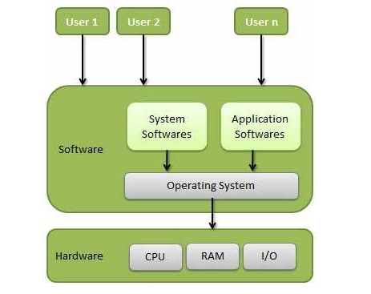
Cont……
An operating system is a program that acts as an interface between the user and the computer hardware and controls the execution of all kinds of programs.
4

Slide 5
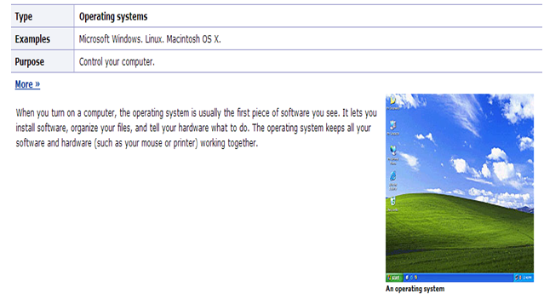
OS contd….
5

Slide 6
What are the goals of OS?
Operating system goals:
Execute user programs and make solving user problems easier.
Make the computer system convenient to use.
Use the computer hardware in an efficient manner.
6

Slide 7
Operating System Objectives
Convenience
Makes the computer more convenient to use
Efficiency
-Allows computer system resources to be used in an efficient manner
Ability to evolve
-Permit effective development, testing, and introduction of new system functions without interfering with service
7

Slide 8
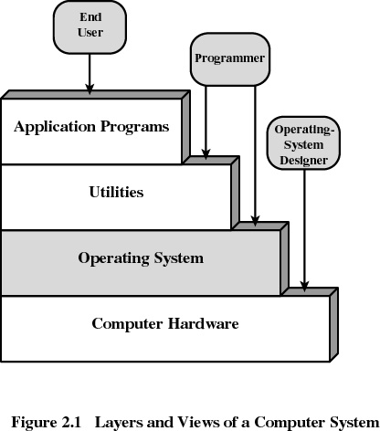
Layers of Computer System
8

Slide 9
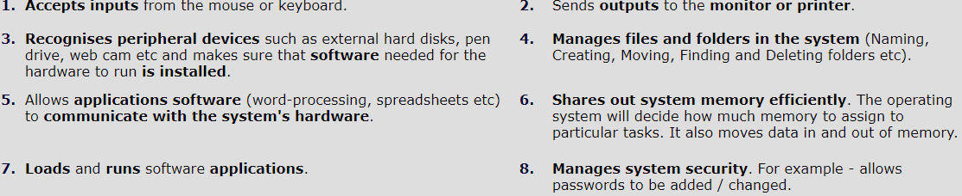
Tasks of the Operating System
Operating systems perform the following function:
9

Slide 10
Other services provided by OS:
Program development
-Editors and debuggers
Program execution
Access to I/O devices
Controlled access to files
System access
10

Slide 11
Error detection and response
- internal and external hardware errors
memory error
device failure
-software errors
arithmetic overflow
access forbidden memory locations
Accounting
-collect statistics
-monitor performance
-used to anticipate future enhancements
-used for billing users
11

Slide 12
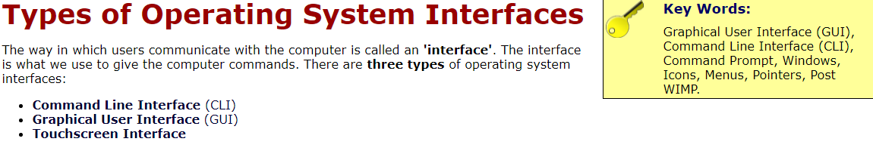
12

Slide 13
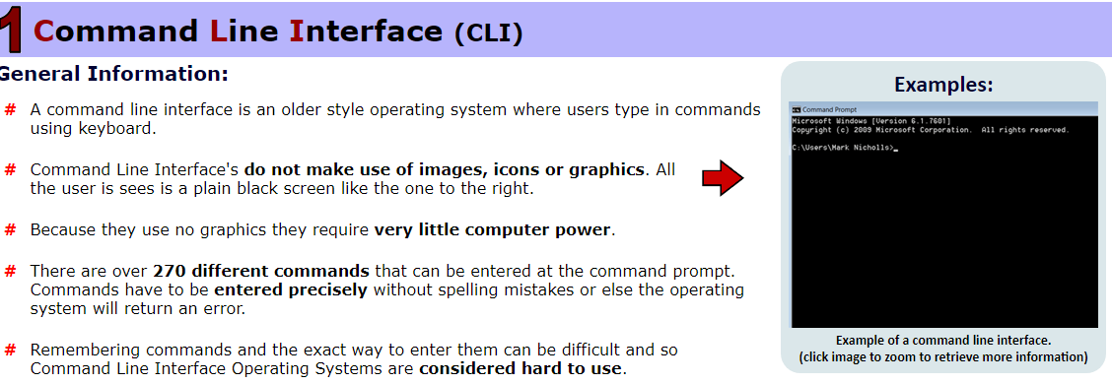
13

Slide 14
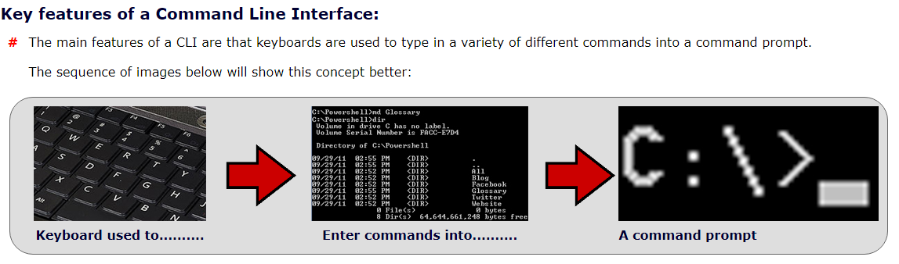
14

Slide 15
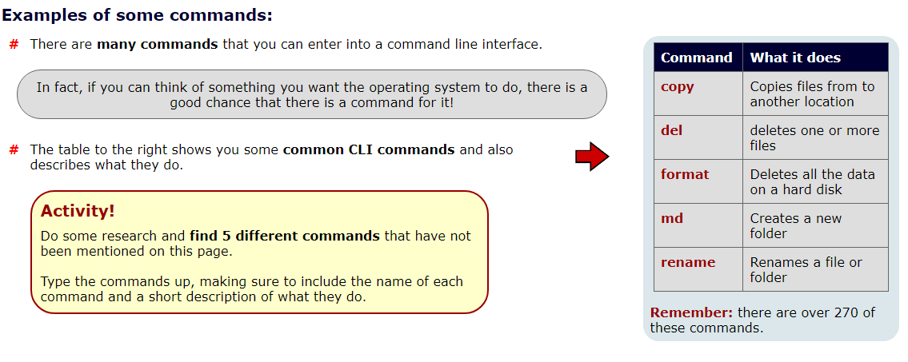
15

Slide 16
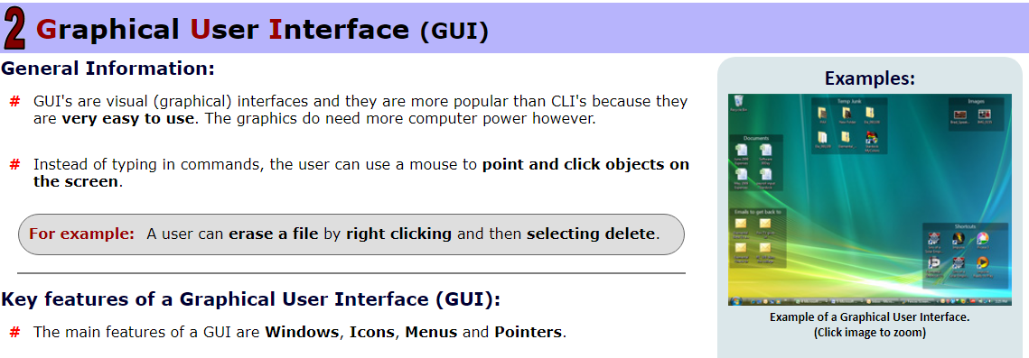
16

Slide 17
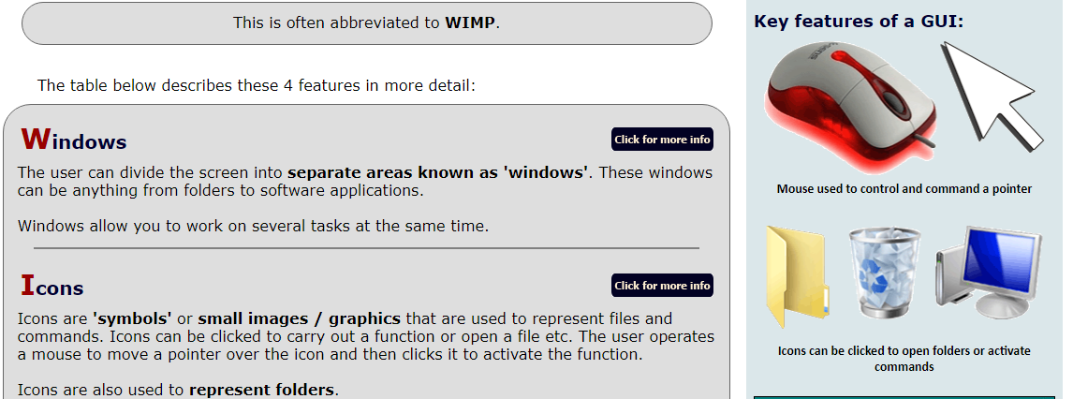
17

Slide 18
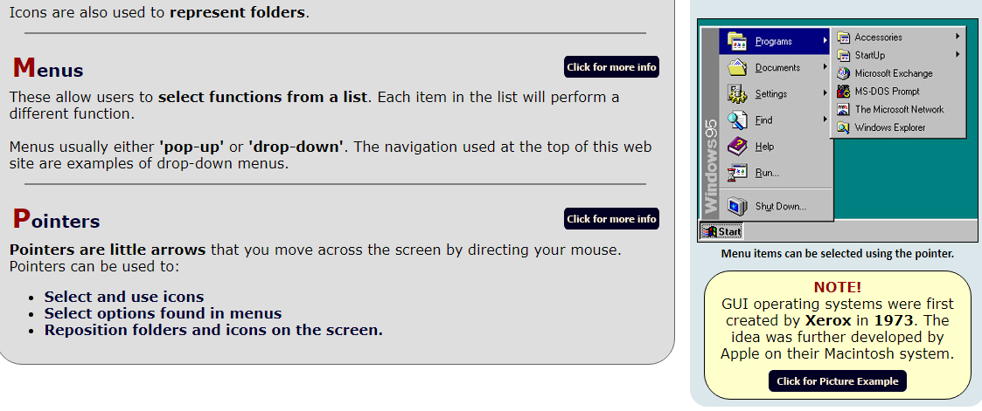
18

Slide 19
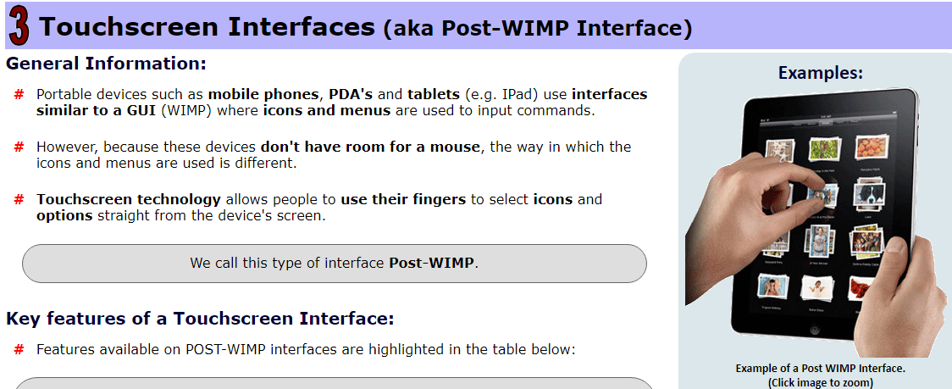
19

Slide 20
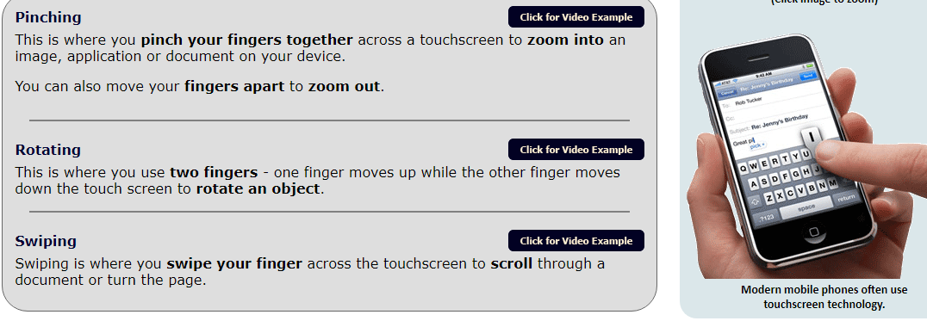
20

Slide 21
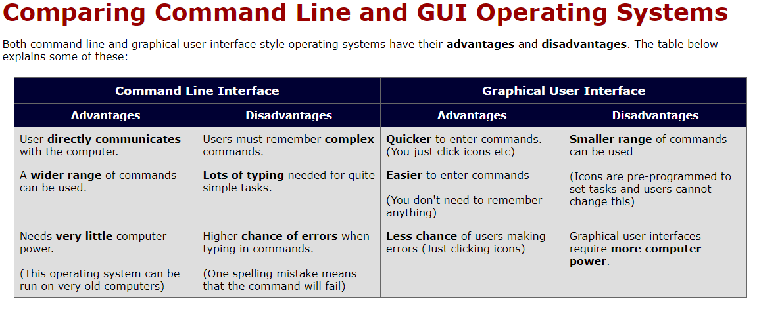
21

Slide 22
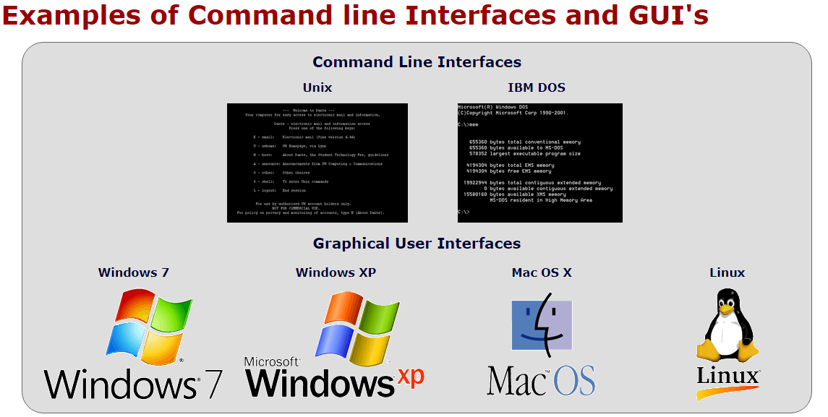
22

